Slide 1
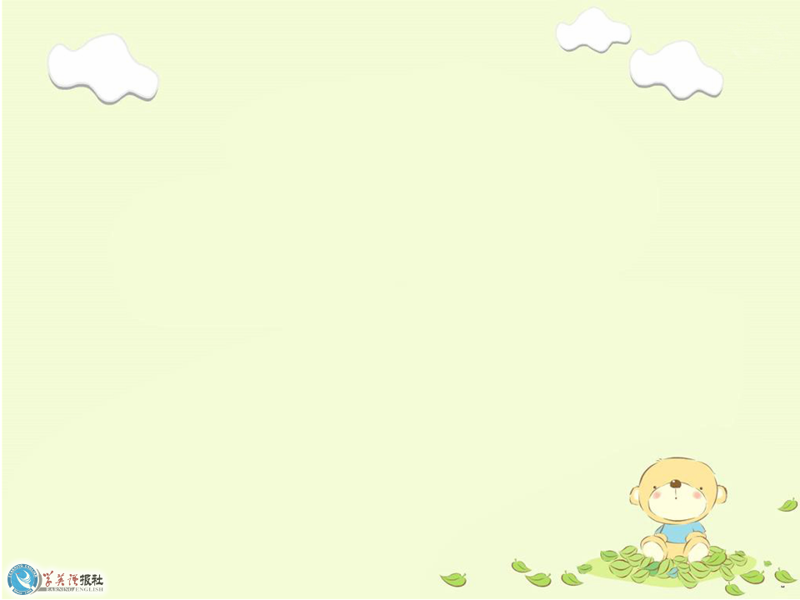
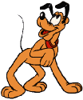
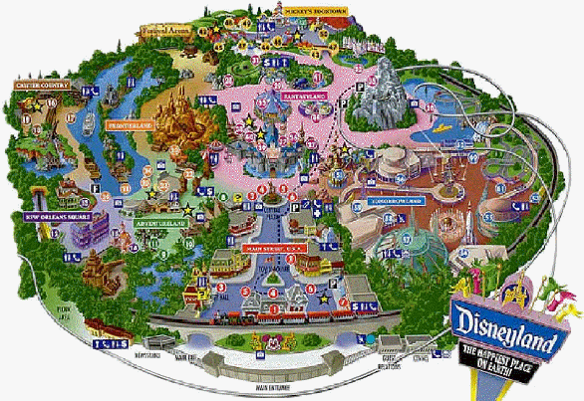
Unit 5
Theme parks

Slide 2
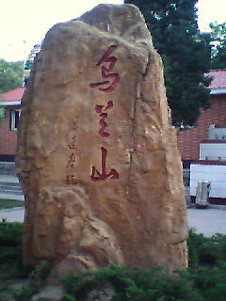
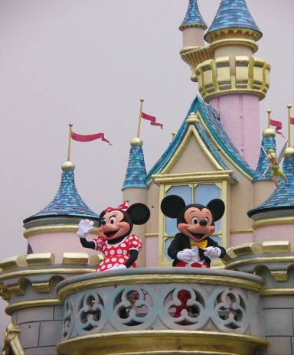
Do you know the differences between
and
a park
a theme park

Slide 3
What is a theme park?
It is a kind of amusement park
which has a certain theme – that the whole park is based on.

Slide 4
What kinds of theme parks do you know?
history theme park
sports theme park
marine or
ocean park
theme
parks
future park
science
theme park
culture theme park

Slide 5

There are various kinds of theme parks in Shenzhen.Would you name some theme parks you know?

Slide 6
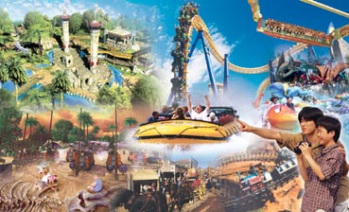
Happy Valley

Slide 7
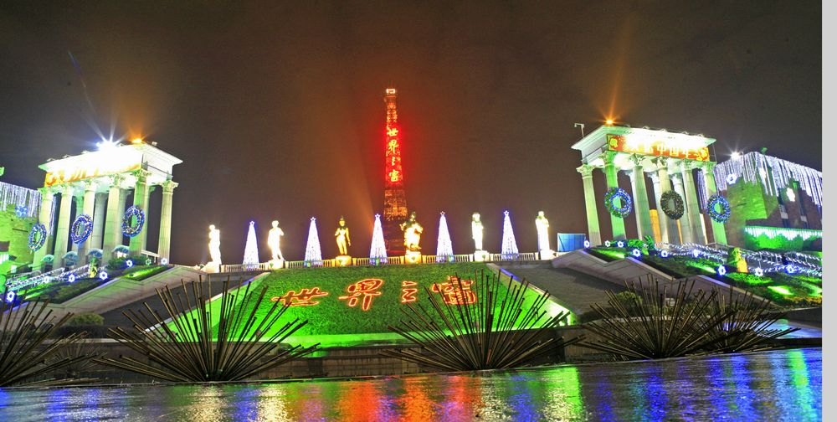
Window of the World

Slide 8
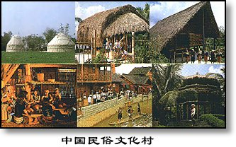
China Folk Culture Village

Slide 9
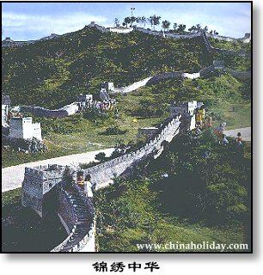
Shenzhen Splendid China

Slide 10
Discussion
With your partner, discuss what kind of activities we can take in a theme park.

Slide 11
These theme parks have a variety of things to see and do.
Sports theme park:
Sports to play or watch; physical exercise and athletic competition.
History theme park:
See how ancestors dressed, worked and lived.
Culture theme park:
See how special groups dress today, what they eat and what the homes look like, cook culture food, take pictures in the special clothing.

Slide 12
Marine or ocean theme park:
See and swim with dolphins and learn about ocean life.
Science theme park:
Take part in experiments.
future park:
Go on imaginary trip to space and experience life in the future.

Slide 13

What are the purposes of the theme parks?
to educate
to entertain
purpose
to make profits

Slide 14
to entertain
There are many rides to go on and shows to see.
to educate
Visitors can learn about history,
cultures and science.
to make profits
Admission fees are charged, extra payment is required for rides and shows, and souvenirs and brand-name items are sold.

Slide 15


Words Review
various
pirate
fantasy
amusement
swing
adj. 不同的；各种各样的
n. 海盗；盗版
n. 幻想；怪念头
n. 消遣；娱乐（活动）
n. 秋千；摇摆
vt. & vi. 摇摆；摆动

Slide 16
Words Review
n. 有吸引力的事物；吸引
n. 旅游业
adj. 独一无二的；仅有的
n. 木匠
n. 匠人；能工巧匠
n. 引擎；发动机
adj. 秃头的
attraction
tourism
unique
carpenter
craftsman
engine
bald

Slide 17
Words Review
vt. 保存；保留 n. 保护区
n. 长度；长
n. 行动；事迹
n. 骑士；爵士
n. 剑
vi.（指中世纪骑士）
骑着马用长矛打斗
n. 锦标赛；联赛
preserve
length
deed
knight
sword
joust
tournament

Slide 18



Skimming
Reading Comprehension I
Answer the question.
What is the meaning of the title “Theme
Parks - Fun and More Than Fun”?
The title means that theme parks are fun to visit, but that they can also be educational and can offer useful information.

Slide 19
Skimming
Reading Comprehension II
Choose the best answer.
What’s the text mainly about?
A. The differences among theme parks.
B. An introduction to three theme parks.
C. Theme parks are more than fun.
D. Disneyland is more popular than other
theme parks.

Slide 20
Skimming
Reading Comprehension III
Find the topic sentence of each paragraph and fill in the blanks.
Para. 1
There are various kinds of theme parks
Para. 2
If you want to have fun and more
than fun, come to Disneyland.
Para. 3
Come to Dollywood to have fun
learning all about America’s historical
southeastern culture.
Para. 4
To enter a world of fantasy about
ancient England, come to Camelot Park.

Slide 21
Scanning
Reading Comprehension V
Complete the table below.
Park name | Theme | Example of Activities
Disneyland
Dollywood
Camelot

Slide 22
Park name | Theme | Example of Activities
Dolly- wood
listen to American country music,
see traditional craftsmen and their work,
try some traditional candy,
ride on an old steam-engine train,
see bald eagles,
ride on Thunderhead and other rides
culture of
the
south-eastern
USA

Slide 23
Park name | Theme | Example of Activities
Disneyland
fairy tale
stories
travel through space, visit a pirate ship, meet fairy tale or Disney cartoon character, ride a swinging ship, go on a free-fall drop

Slide 24
Park name | Theme | Example of Activities
Camelot
ancient English history and stories
watch magic show,
see fighting with swords or on horseback,
visit farm area,
learn about farms in ancient England

Slide 25

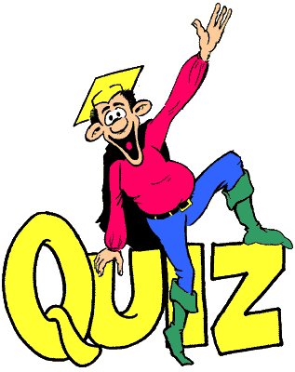
Individual activity

Slide 26

Nowadays, there are _______ kinds of theme parks in the world. Theme parks have a certain idea --- a ______ theme --- that the whole park is ______ on. These parks are _______ for different things. Whichever and whatever you like, there is a theme park for you. For example,
I. Retell the text by filling in
the following blanks.
various
certain
based
famous

Slide 27
Disneyland
__________ is the oldest theme park in the world. It seemed like a place of _______. Dollywood is one of the most ______ theme parks in the world. You can have ____ learning all about American’s _________ southeastern culture. If you want to __________ a world of fantasy about _______ England, come to Camelot Park!
fantasy
unique
fun
historical
experience
ancient

Slide 28

1. various
eg: There are various ways of getting to
the stations from here.
various (kinds of)=a variety of 各种各样的
vary from … to … …和…之间存在不同

Slide 29

由于各种原因，我不愿见他。
For various（kinds of ) reasons, I prefer not to meet him.
我们的主题公园有各种各样的娱乐设施，你总能找到一款适合你们小孩的。
There are a variety of amusement facilities in our theme park, so you can always find one suitable for your children.

Slide 30
2. be famous for
纽约以其摩天大楼驰名，每年吸引了大量的游客。
Famous for its skyscrapers, New York attracts a large number of tourists every year.
be famous for =be known for
be famous for = be known as
作为…而闻名
以……而闻名

Slide 31
北京， 作为中国首都，正遭受严重的污染。
Beijing, known as the capital of China, is being polluted severely/seriously.

Slide 32
3. whichever& no matter which
______ team wins on Saturday will go through to the national championships. (2006山东)
A. No matter what
B. No matter which
C. Whatever
D. Whichever

Slide 33
4. amuse v. 使发笑；使愉快
These toys will help to keep the baby _______.
To my great___________, his false
beard fell off.
Our visits to the theatre made the holiday more ________.
Everyone was _______ at the story about the dog.
amused
amusement
amusing
amused

Slide 34
5. attraction
n. 有吸引力的事物；吸引；吸引力
One of the main attractions of the job is the high salary.
这份工作最吸引人的是薪水高。
She felt an immediate attraction to him.
她对他一见钟情。

Slide 35

Choose the best answer.
practice
I can't see the _______ of sitting on the beach all day.
A. attraction B. appreciation
C. attention D. application

Slide 36
6. no wonder
难怪；不足为奇
No wonder the firm makes a loss; the office is terribly overstaffed.
难怪公司亏损，办公室严重超编。
No wonder you were late!
难怪你来晚了!

Slide 37
Choose the best answer.
practice
______ the children are excited — this is the first time they’ve been abroad.
A. No hurry B. No wonder
C. No need D. No problem

Slide 38
7. wherever
adv. & conj. 无论在什么地方；各处
Sit wherever you like.
您愿意坐在哪儿都行。
I'll find him, wherever he is.
不管他在哪儿我都要把他找到。
Wherever she goes, there are crowds of people waiting to see her.
她所到之处都有成群的人等着见她。

Slide 39
Choose the best answer.
practice
In peace, too, the Red Cross is expected to send help _____ there is human suffering. (2006江西)
A. whoever B. however
C. whatever D. wherever

Slide 40
8. preserve
Few of the early manuscripts have been
preserved.
早期的手稿保存下来的不多。
His work must be preserved for
posterity (子孙；后代).
他的作品当传诸后世。
vt. 保存；保留
n. 保护区
No hunting is allowed in the preserve.
保护区内禁止打猎。

Slide 41
Choose the best answer.
practice
At minus 130℃, a living cell can be ______ for a thousand years. (2007上海)
A. spared B. protected
C. preserved D. developed

